Slide 1
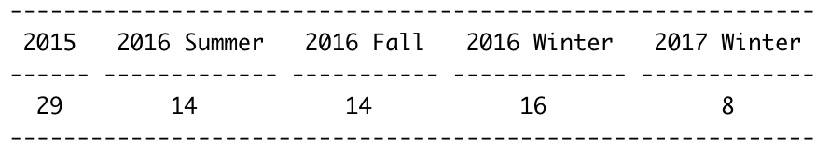
Distribution of Responses by Cohort

Slide 2
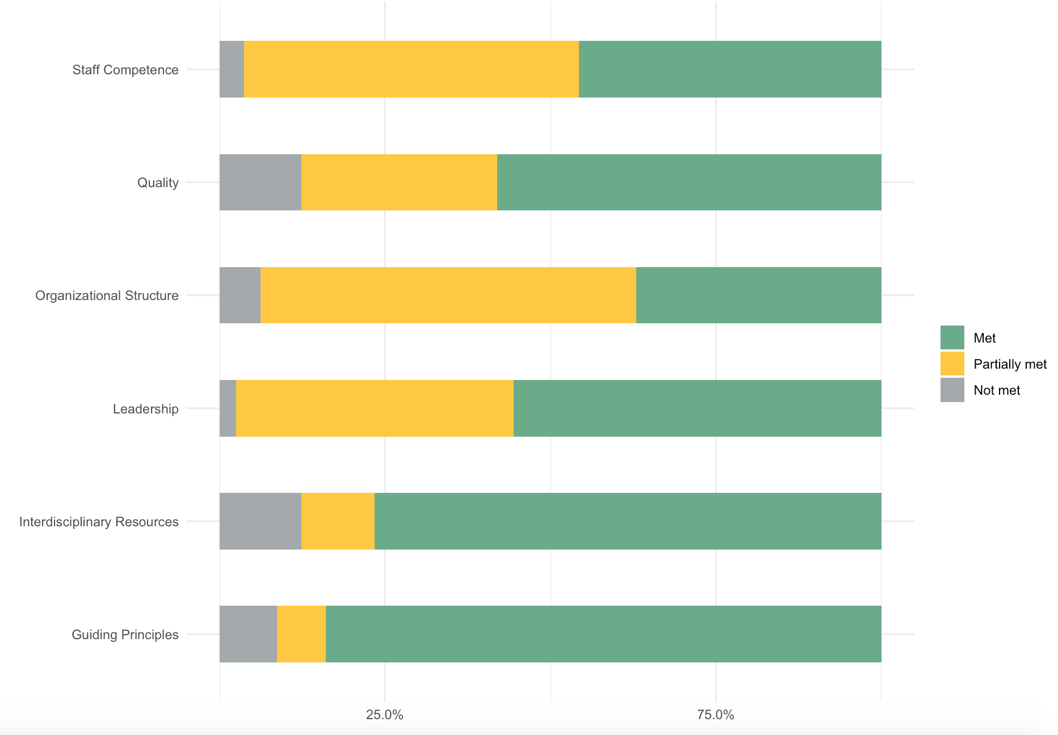
Distribution of
Year-1 Implementation
Responses

